Slide 1
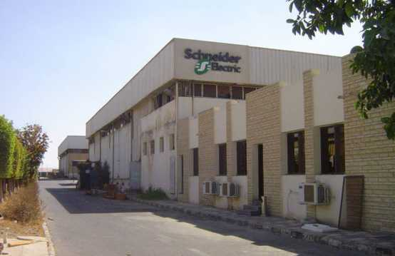


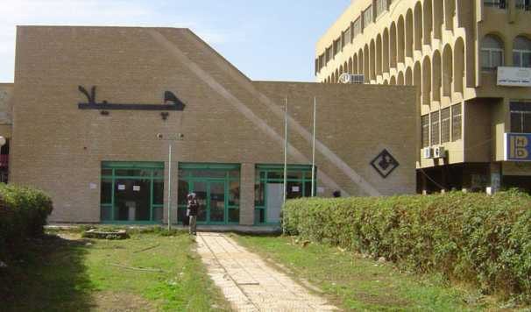

Gila Factory
10th of Ramadan
14000 sq mt
150 technicians
30 Engineers/staff

Slide 2
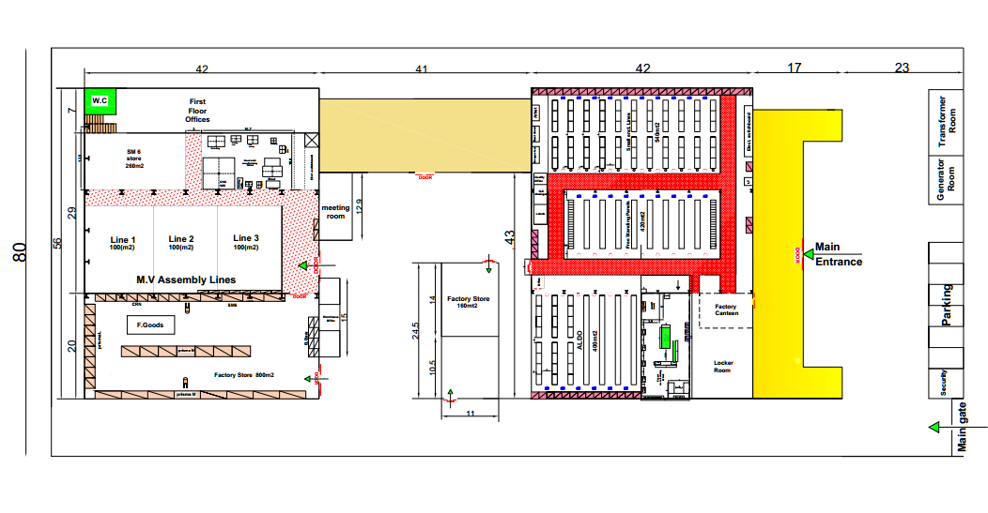
10th of Ramadan Factory layout

Slide 3
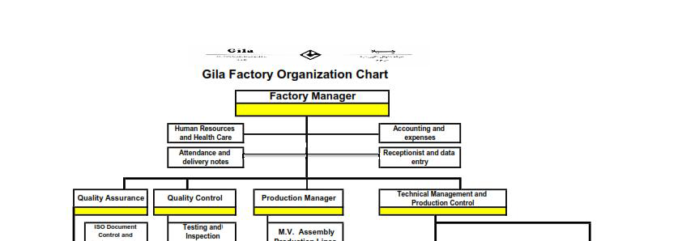
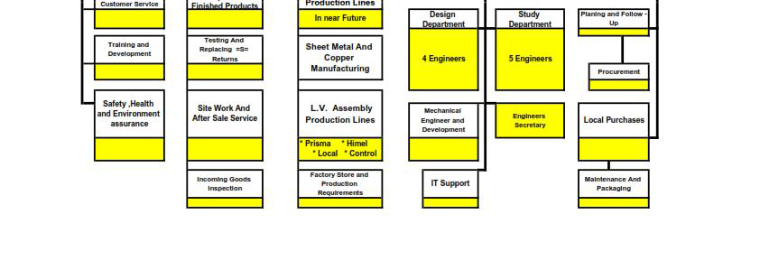

Slide 4
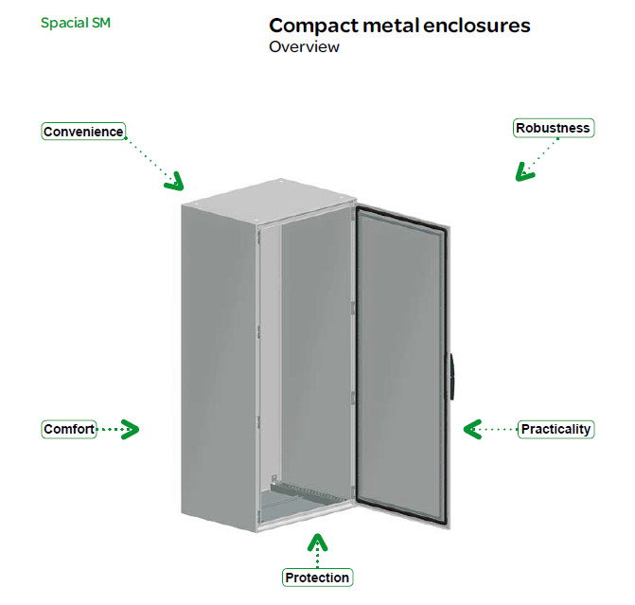
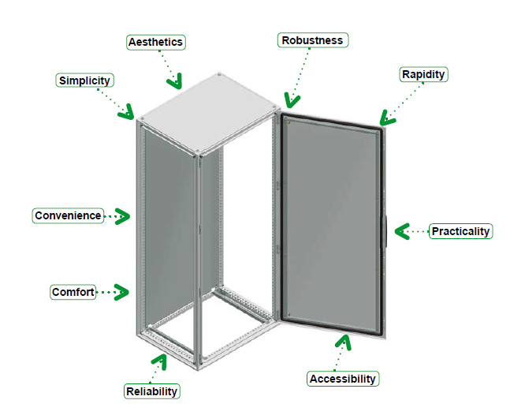
Universal Enclosures IP 55 Floor-standing enclosures up to 5000 Amp

Slide 5
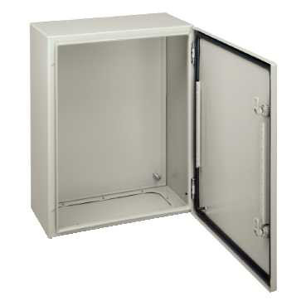

Universal Enclosures IP 66 for 1 door Wall Fixing Metal Enclosures IP 66 for 1 door .
NSYCRNG128300
Special CRNG plain door w/o mount. Plate.
H1200xW800xD300 IP66 IK10 RAL7035 IP 66 conforming to IEC 60529
NSYCRNG1210400D
Special CRNG plain door w/o mount. Plate.
H1200xW1000xD400 IP55 conforming to IEC 60529

Slide 6
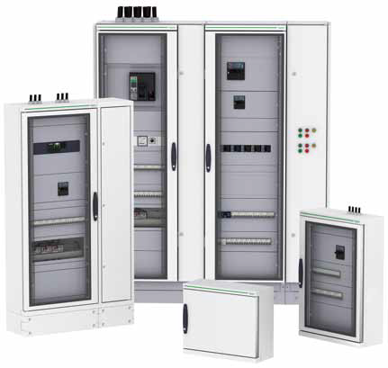
Prisma iPM
Using our Prisma iPM solution, you can easily
design, implement and operate low voltage
electrical distribution and control switchboards
that are dependable, because they are optimized, tested and compliant with the IEC 61439 -1 Standard.

Slide 7
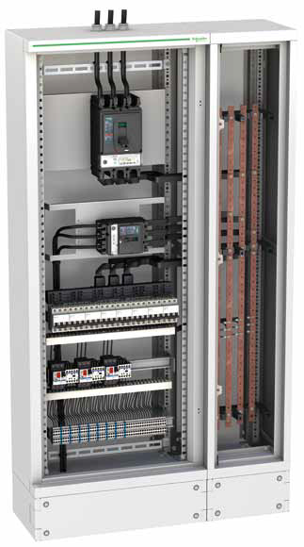
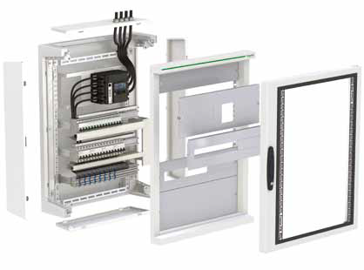
Wall mounted system L
up to 630 A
Dedicating ourselves to safe, simple LV Switchboards. a modular and
prefabricated solution based on a complete system in kit form that perfectly integrated

Slide 8
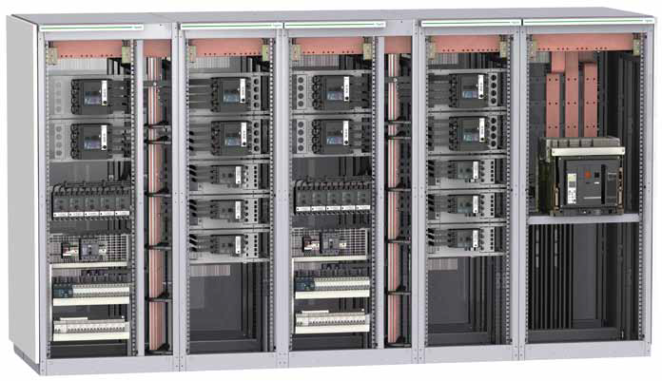
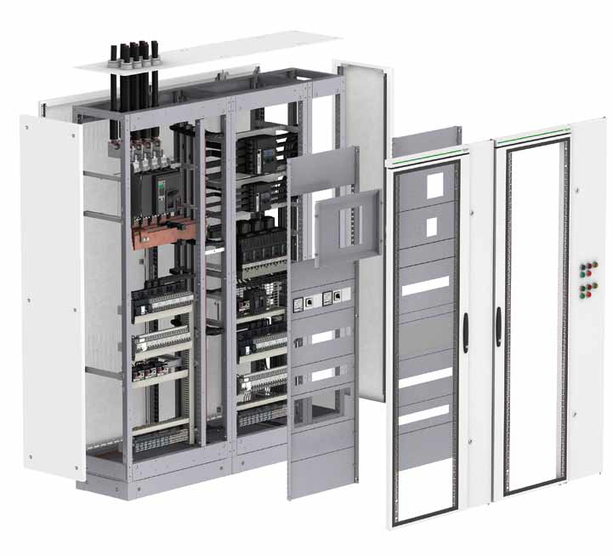
Free Standing system M
up to 4000 Amp

Slide 9
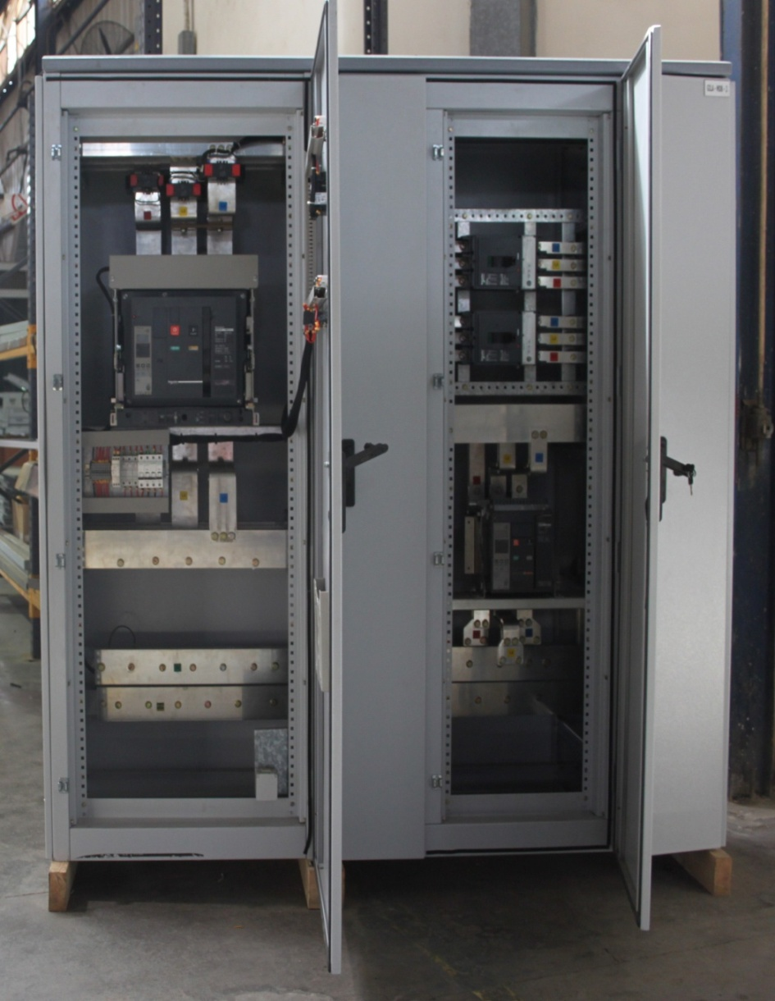
ALDO by GILA
Gila would like to introduce you to our latest edition: “Aldo”. Aldo is Gila’s new edition to the local low voltage collection, with innovative
features, and affordable pricing. Aldo is a low local voltage switchboard type-tested panel by ASTA. We chose “Aldo” as our name to revive the good memory of the main founder of Gila.Panels assembled or made by Gila range in modular multi-functional switchgears, assuring high level of reliability

Slide 10
ELECTRICAL CHARACTERISTICS
MAIN DISTRIBUTION PANEL UP TO 2500 AMP
(Floor Standing Switchboard)
Rated voltage: - Un = 380/220V
Rated operational voltage: - Ue = 440V
Rated Insulation voltage: - Ui = 1000V
Rated impulse withstand voltage: - Ump = 2.5KV
Rated current: - Ina = 2500A @40°C
Rated short time withstand current: - Icw = 50KA/1sec
Rated peak withstand current: - = 105 KA
Rated conditional short circuit current: - Icc = 36KA
Rated frequency: - fn = 50HZ
IP code: - IP54

Slide 11
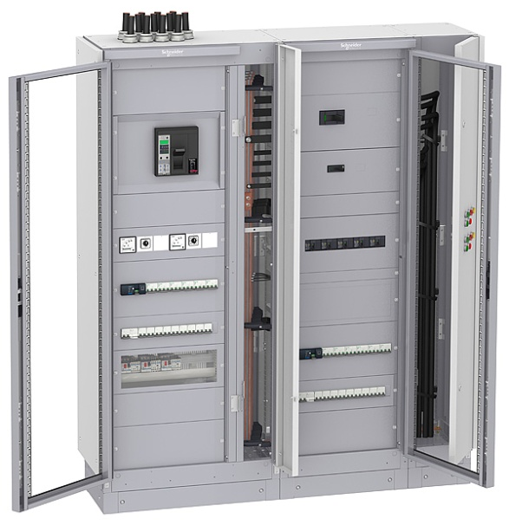
Let’s pool our energies for building dependability
ALDO Floor standing, the result of more than 10 years GILA ELECTRIC experience in low-voltage electrical-distribution switchboard systems
ALDO Floor standing is a type tested switchboard and comply with IEC 61439-1,2 standard
safe and reliable switchboards that guarantee the comfort for your customers, employees and buildings
ALDO Floor standing switchboards for commercial and industrial buildings with :
Electrical protection solutions up to 2500A
Motor control starter solutions up to 45 kW

Slide 12
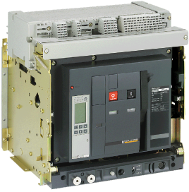
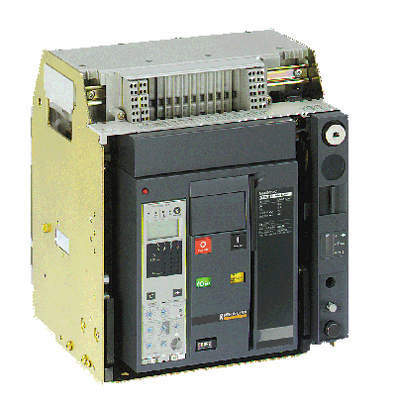
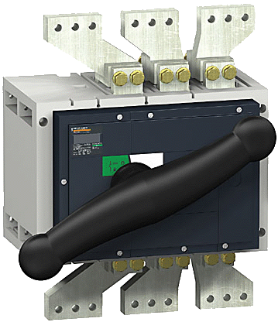
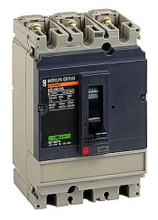
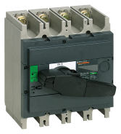
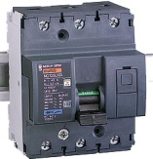
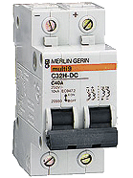
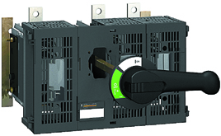
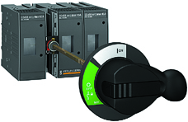
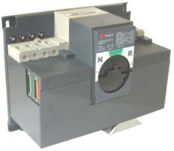
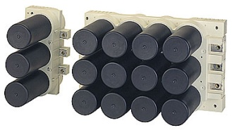
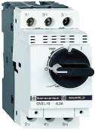
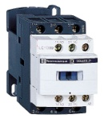
ALDO Floor Standing designed and tested with devices
Schneider offers a wide range of products
World leader in low voltage electrical distribution
Among leaders in industrial and building automation and control
ALDO integrates devices up to 2500 A
Circuit Breakers with Master pact, Compact, Easy pact and Acti 9 ranges
Switch disconnectors with Inter pact range
Fuse-switches up to 630 A with Fuspact range
Source changeover and transfer switch solutions up to 600A
Capacitor bank Varplus box solutions up to 300 kVAR per column
Motor control center devices up to 45 kW with GV2 & LC ranges
Notes:
Schneider Electric, the global specialist in energy management, offers integrated solutions making energy safer, more reliable, efficient and productive in the energy & infrastructure, industry, data centres & networks, buildings and residential markets. With sales of 17.3 billion euro in 2007, the company's120,000 employees in 102 countries help individuals & organisations make the most of their energy.
Quality is guaranteed by the solutions designed and tested taking into account devices made by Schneider.

Slide 13
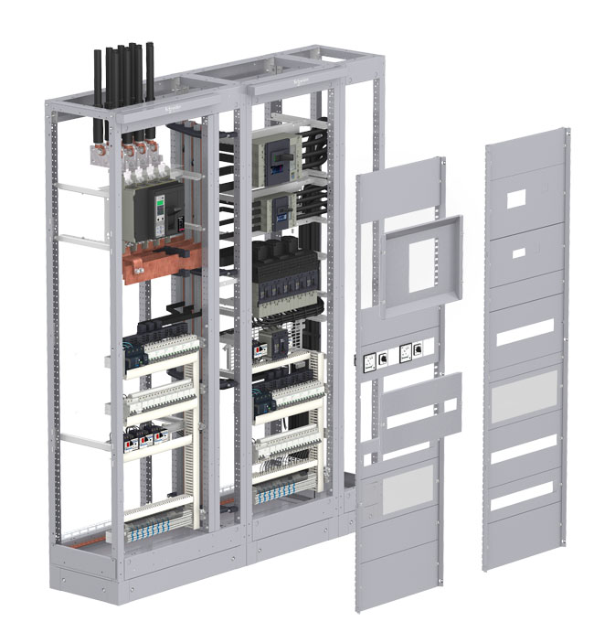
Functional Units
Mounting plates for devices in horizontal or vertical position
Cable duct for outgoing cables
Flexible bars for the connection to busbars
Bar duct to connect laterally functional units to busbars
Same mounting plates in front or rear connection
Front plates on removable supports to check the position of the functional units
Holes on the removable supports every 25 mm to install front plates
Holes on the framework every 25 mm to install supports of mounting plates (and supports of busbars)
Front plates with cut-outs dedicated to devices
Bar drawings provided
Space dedicated for functional units is 36 modules high (1800 mm)
Transparent or plain front plates
Cable running solutions for outgoing cables of functional units
Mounting plates dedicated to each type of device:
- The device is automatically positioned with respect to the front, whatever the cover panels selected
- universal mounting plates for any device whatever the size

Slide 14

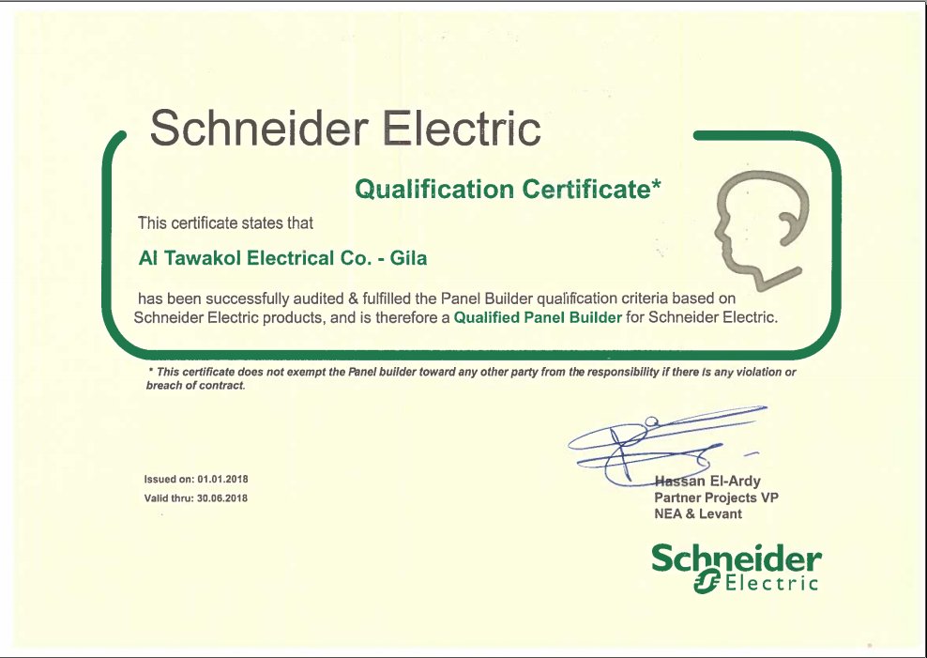

Slide 15



Slide 16
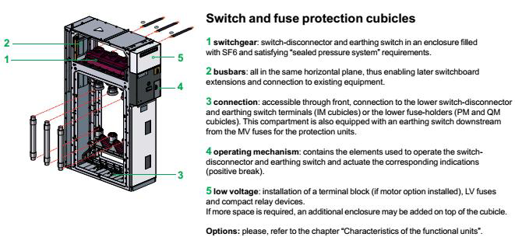
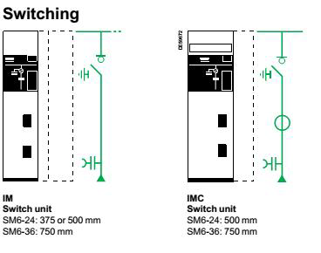
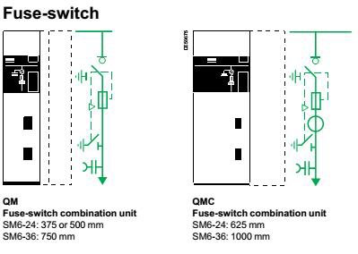

Slide 17



Slide 18
Routine TESTS for all our panels
The tests carried out in our factory on the switchboard are in accordance
with the IEC standards, and include:-General presentation
Building up conformity according to the construction drawings
Mechanical tests And Checking of interlocking devices
Electrical test of the low voltage equipments
Power frequency withstand voltage test
Dielectric test for Bus bar (Insulation tests).

Slide 19
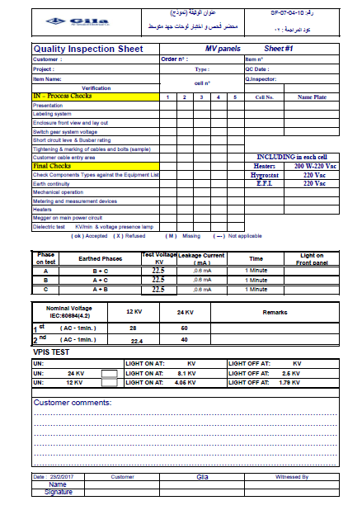
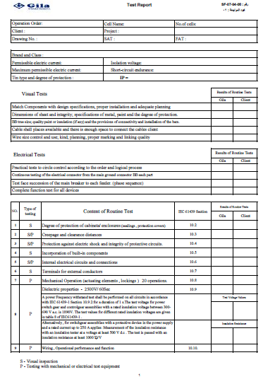

Slide 20
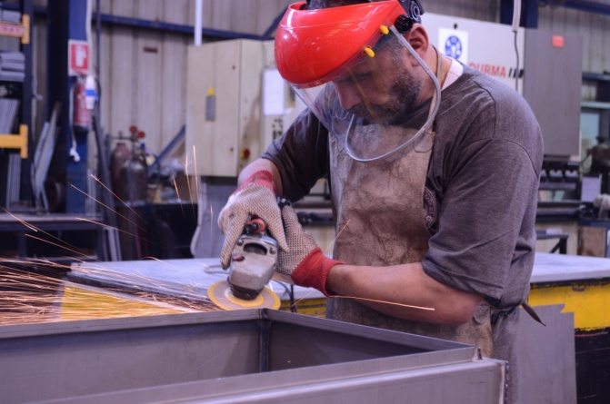
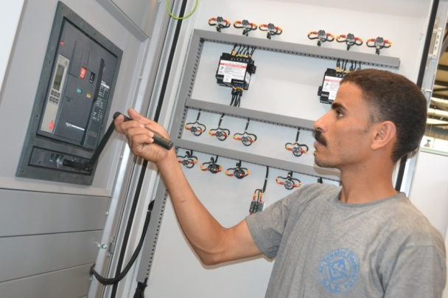
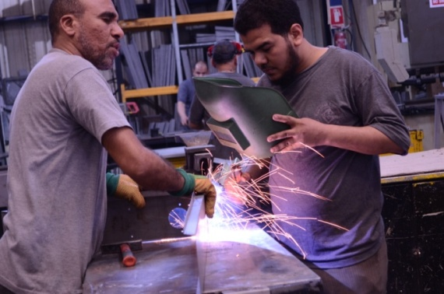
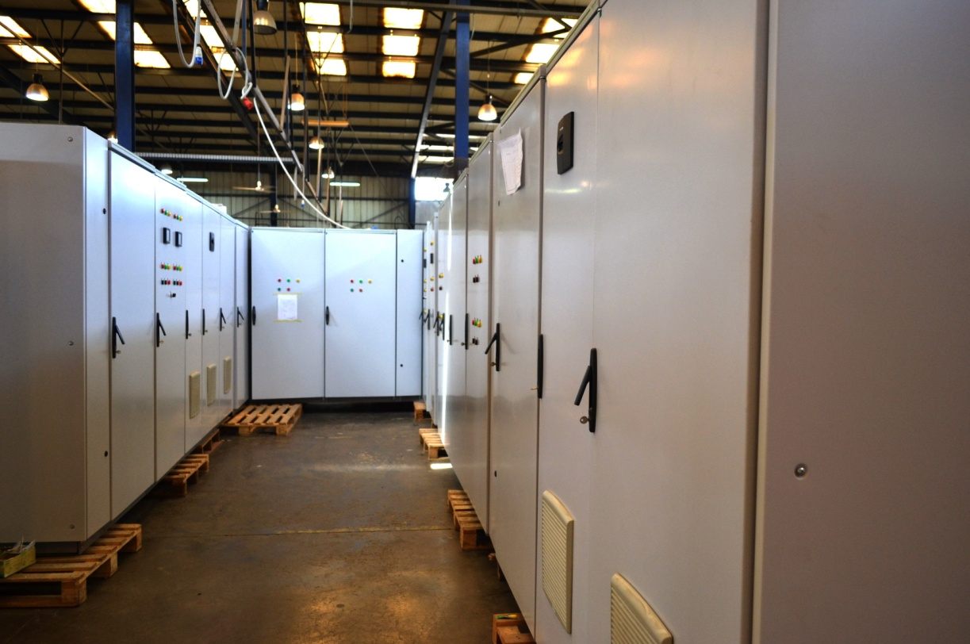
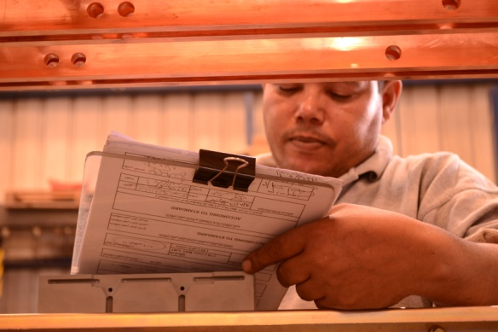
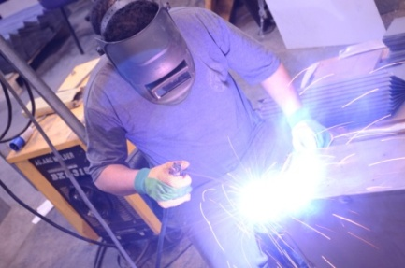
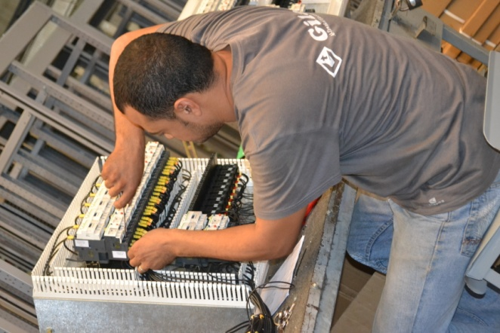
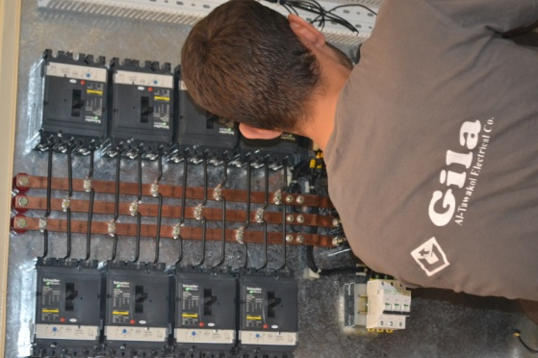
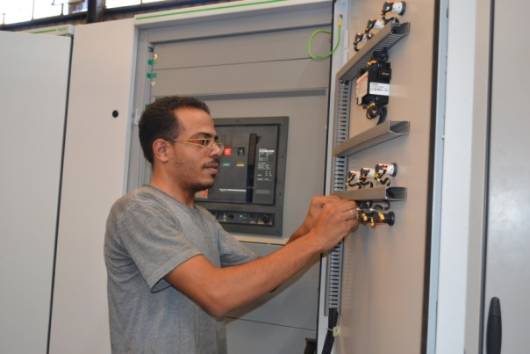
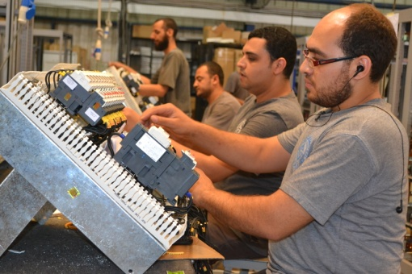
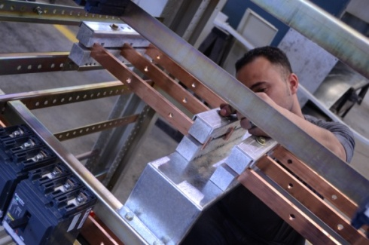
Quality Manual
دليل الجودة

Slide 21
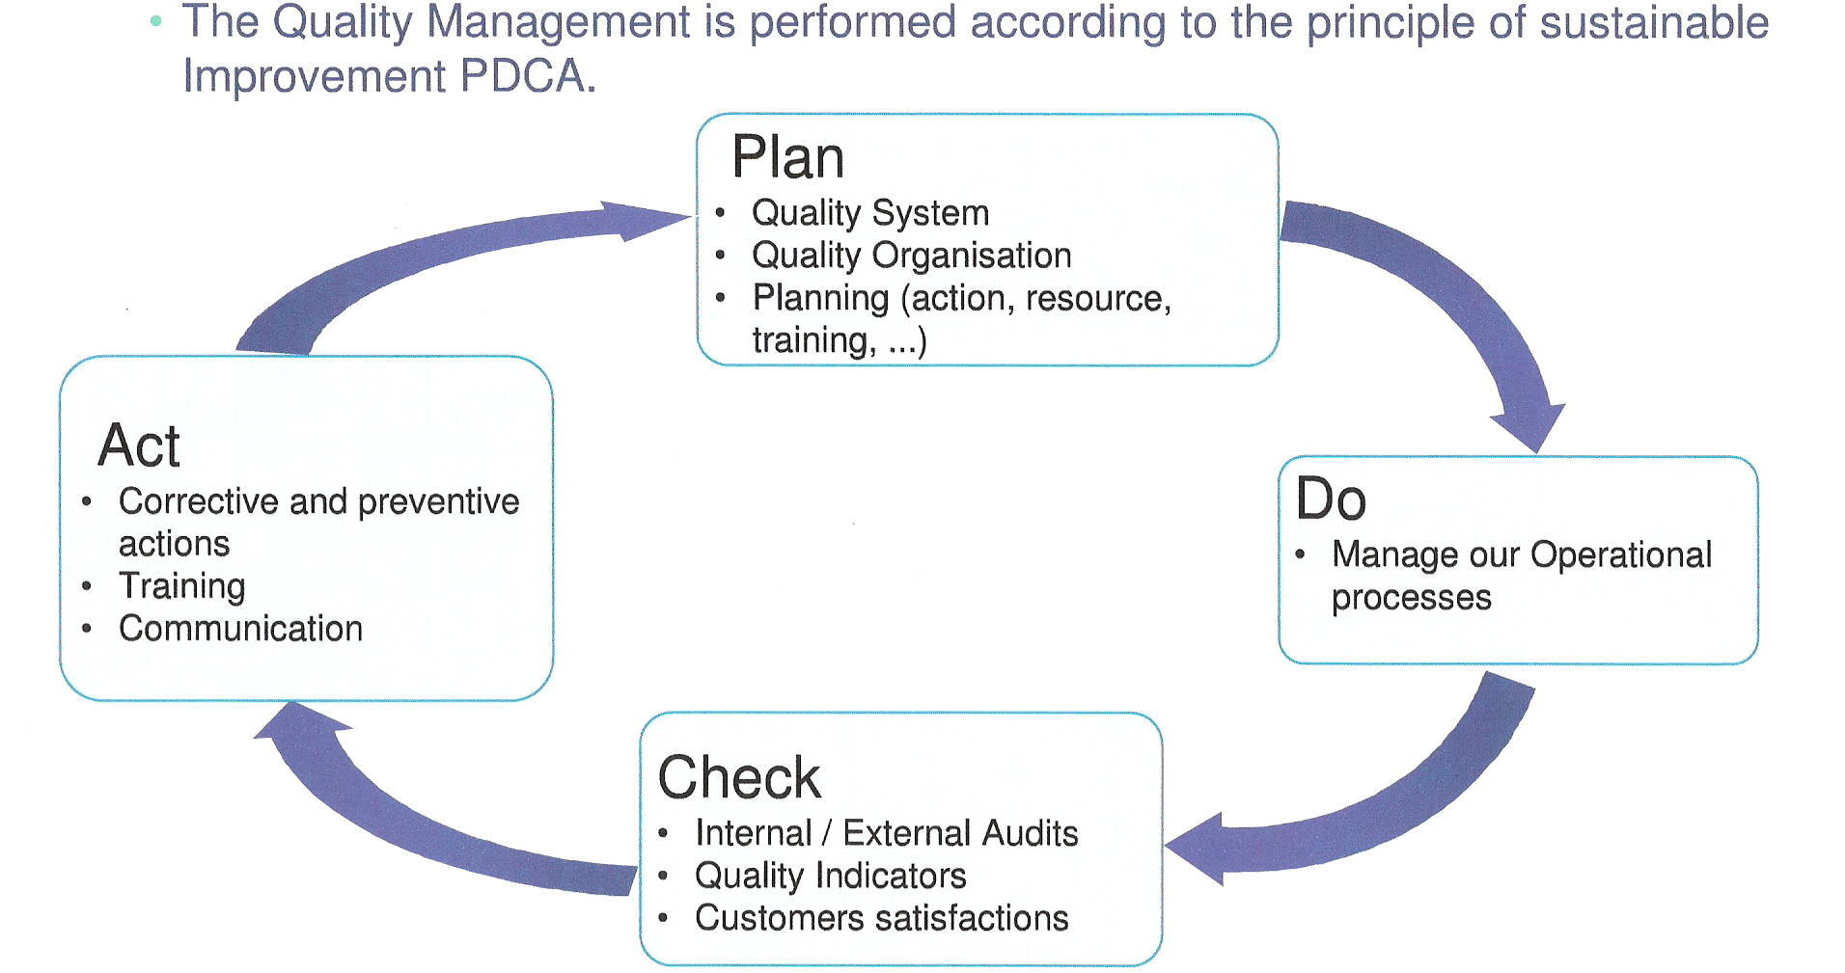

Slide 22
Vodafone Panel 6000 Amp

Slide 23
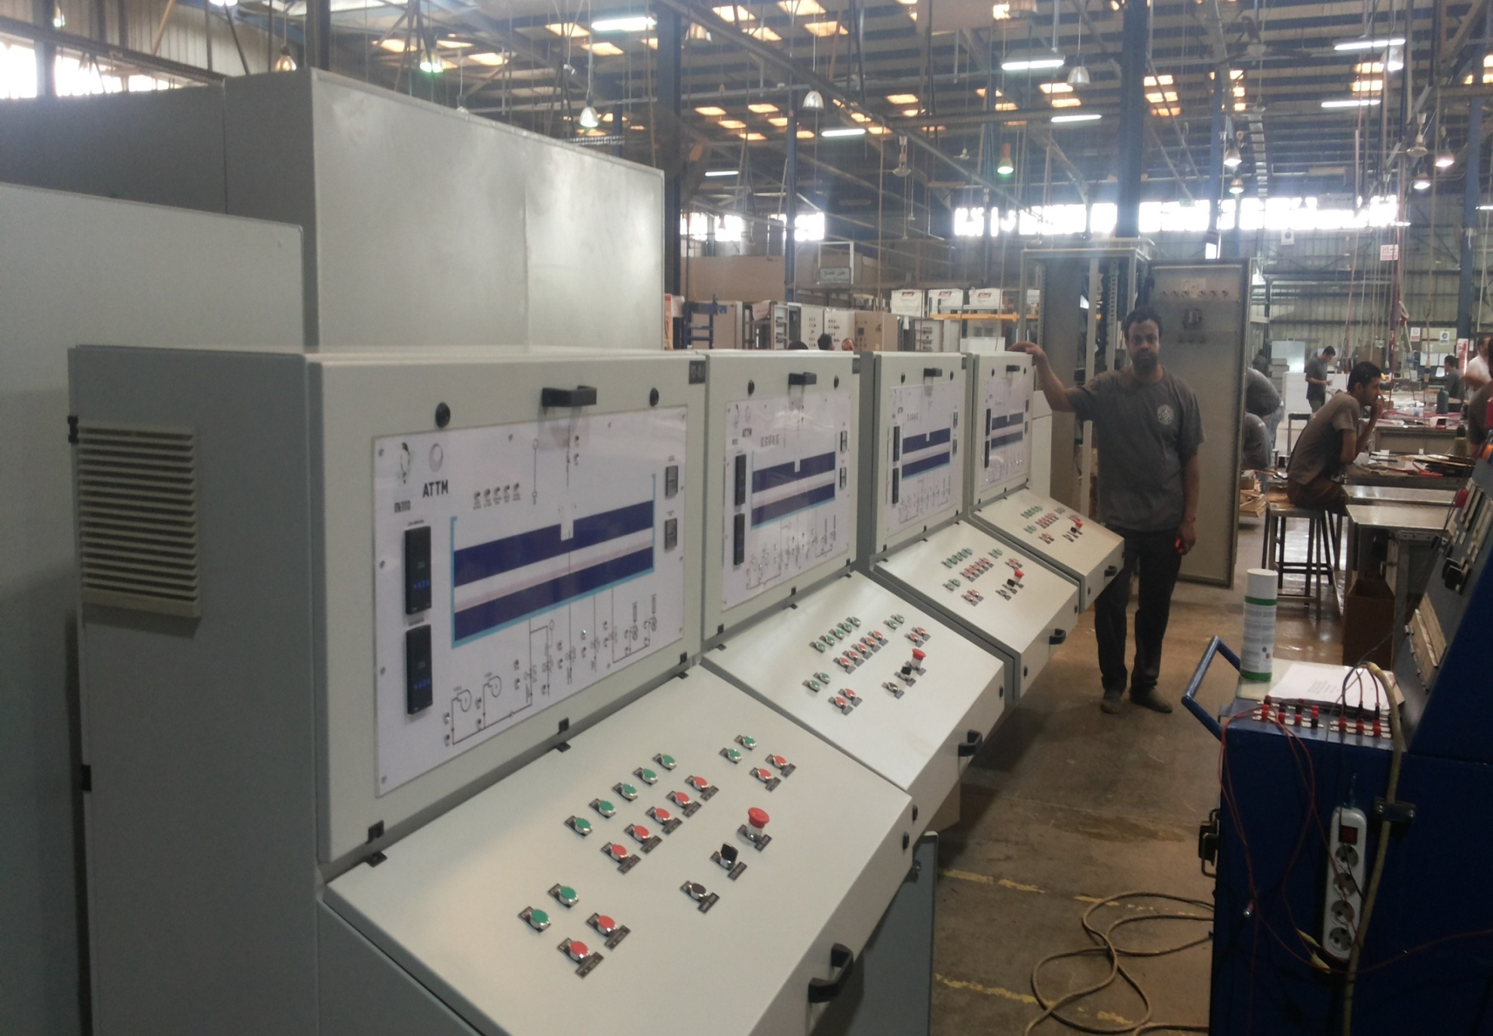
Moritania Control Desks

Slide 24
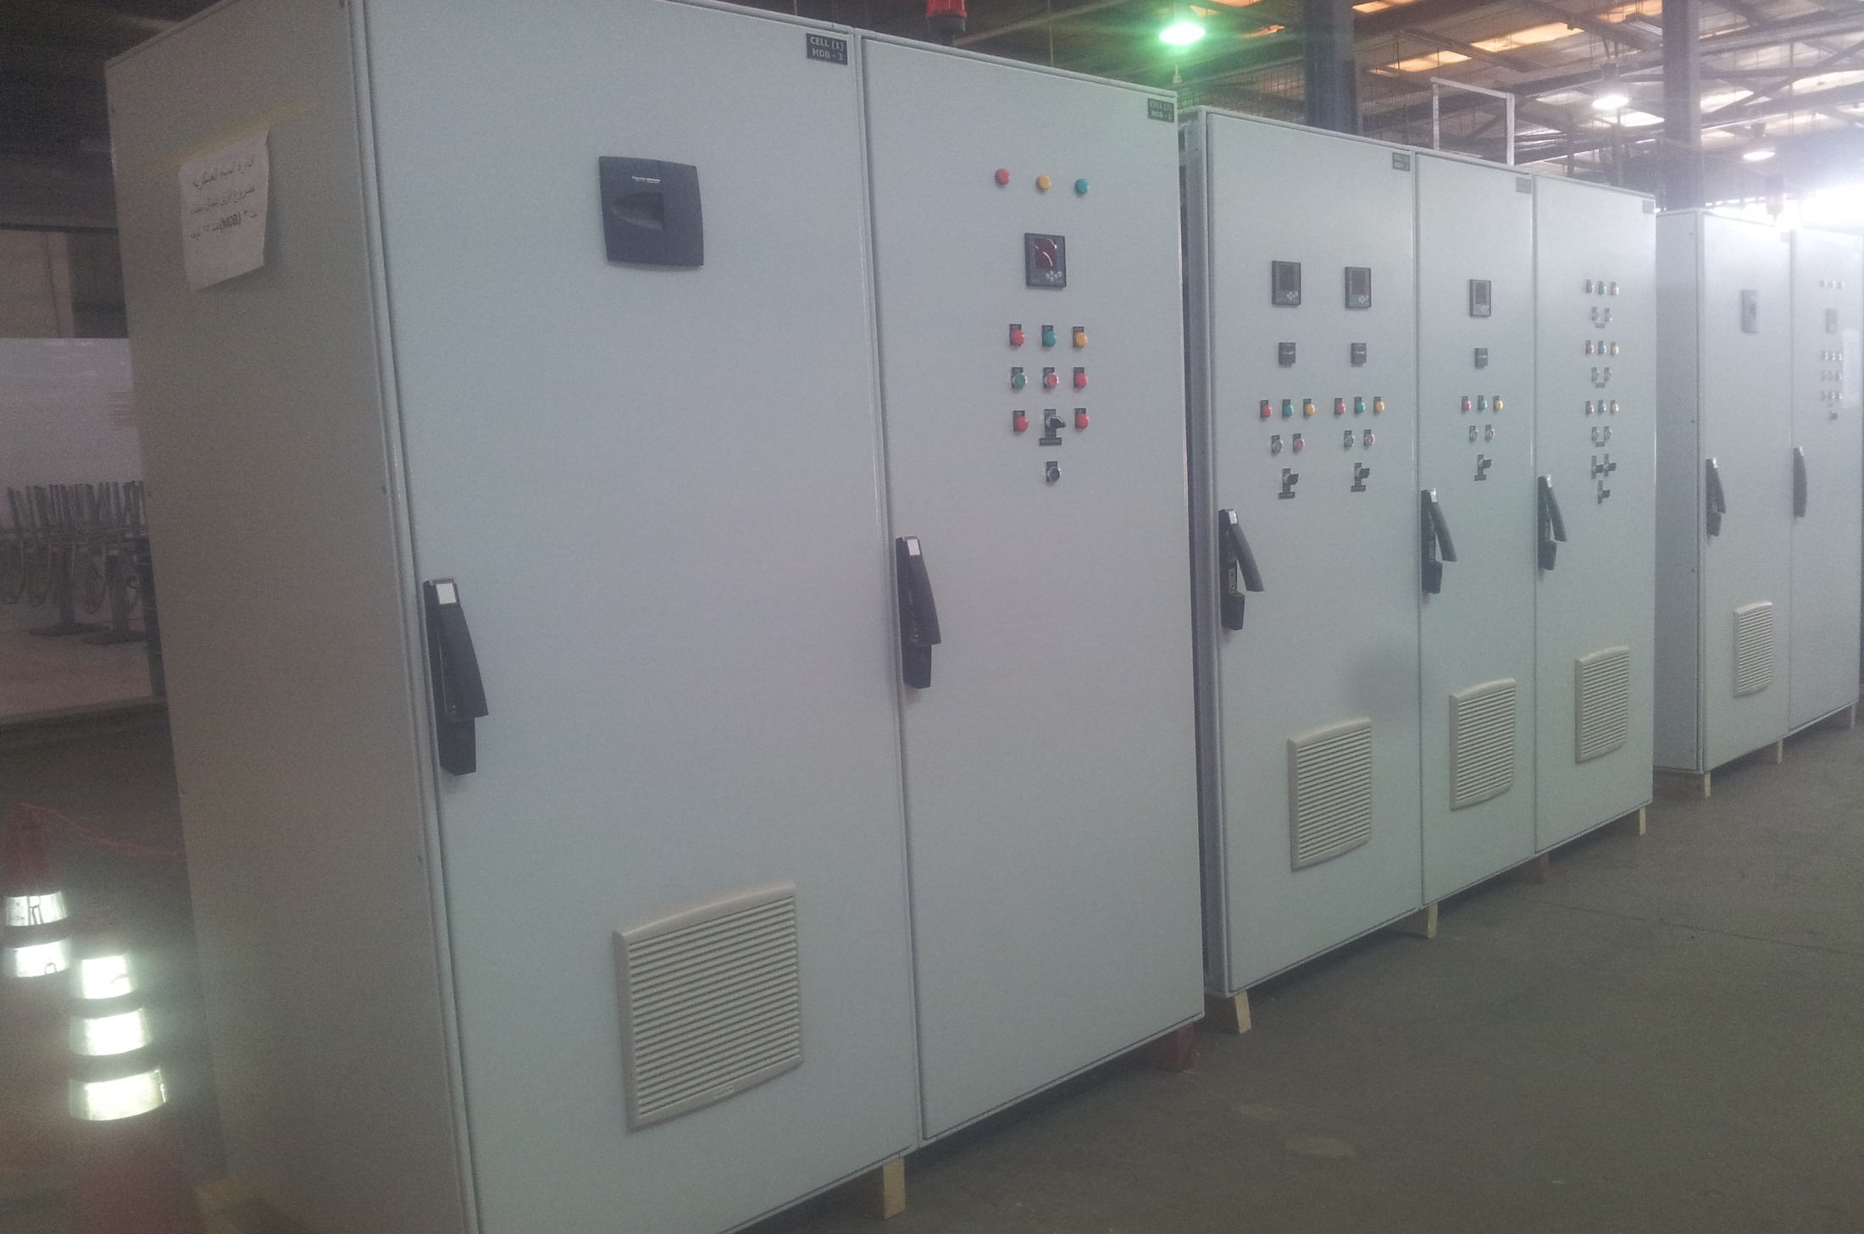
ادارة المياة العسكرية

Slide 25
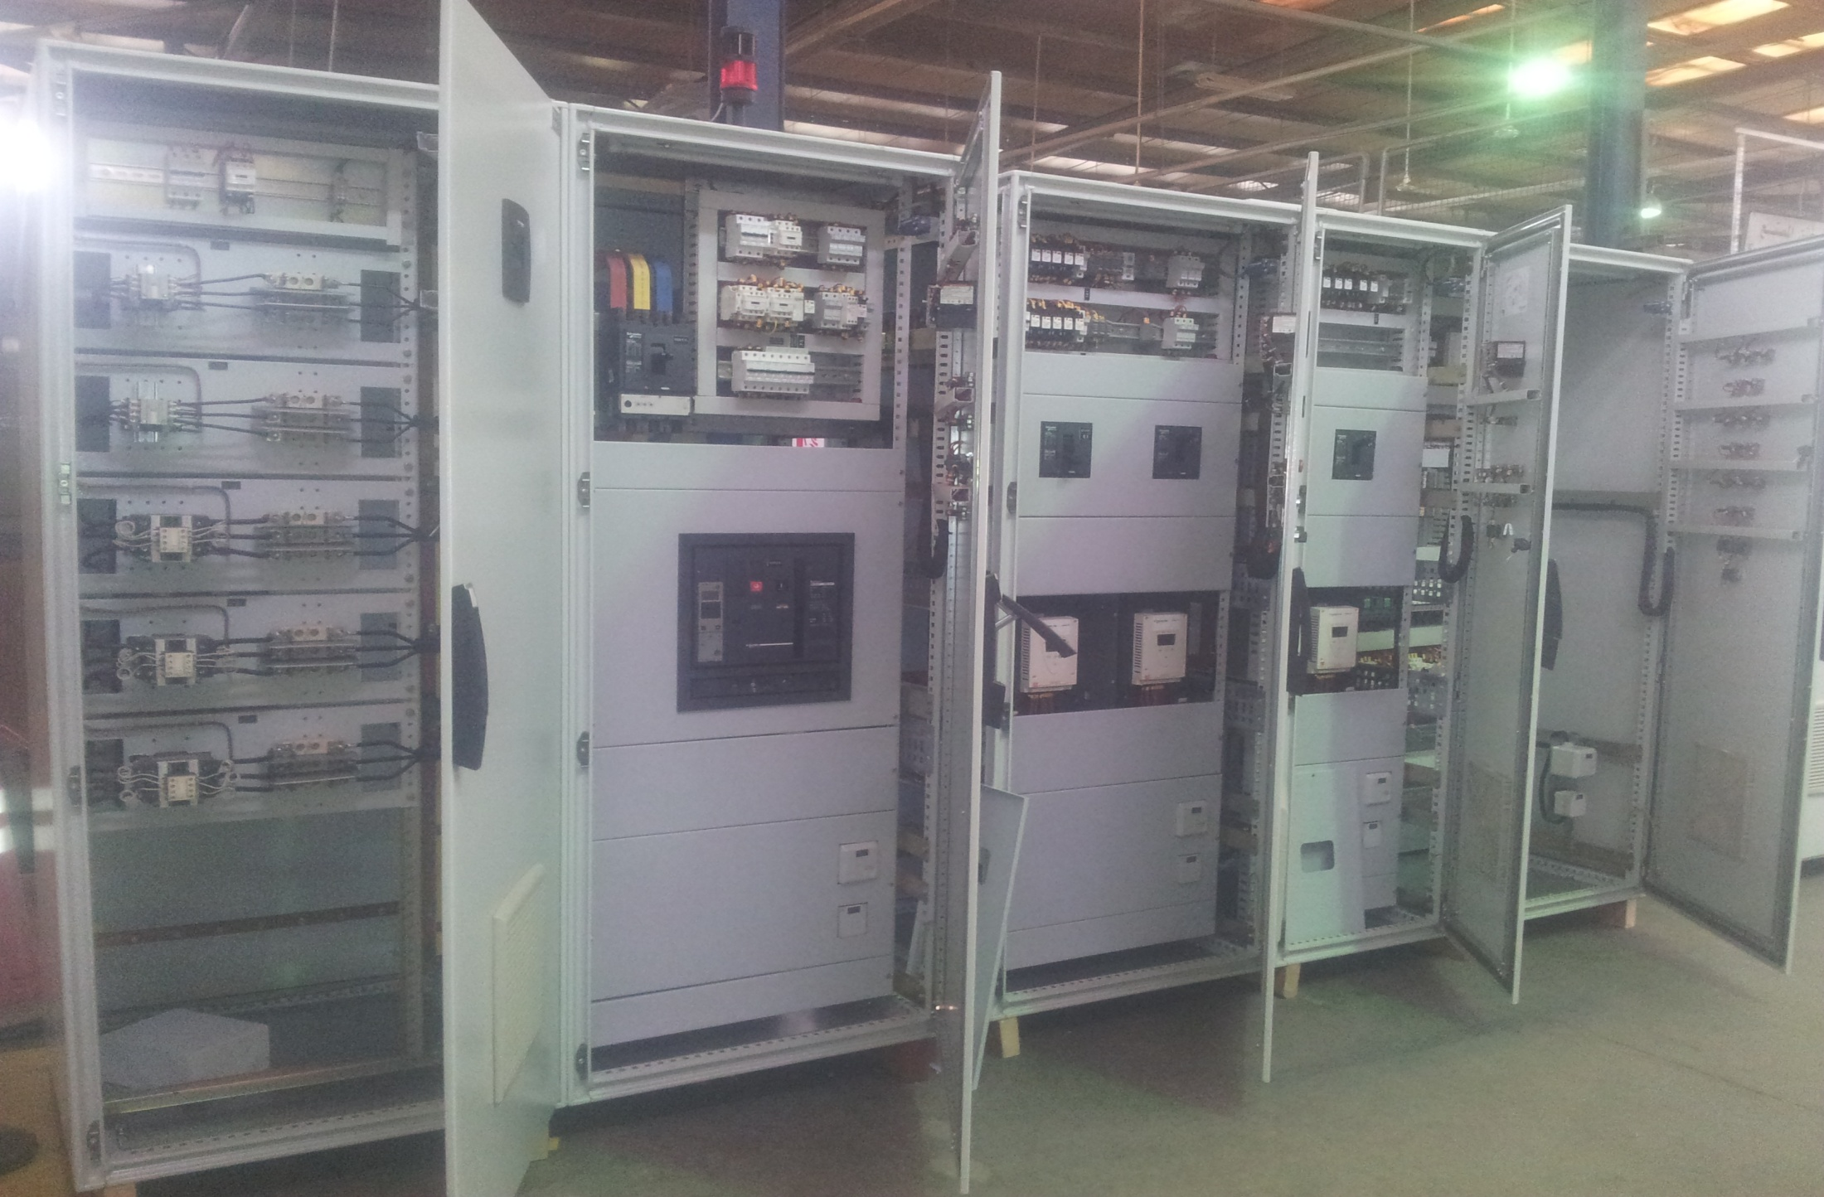
ادارة المياة العسكرية

Slide 26

Raya مشروع ( اتصالات مصر )

Slide 27



ISO Certificates
9001
14001
18001

